Slide 1
Light and day
During the day the Sun is in the sky.
The light from the Sun is very bright.
Sun
Sky

Slide 2
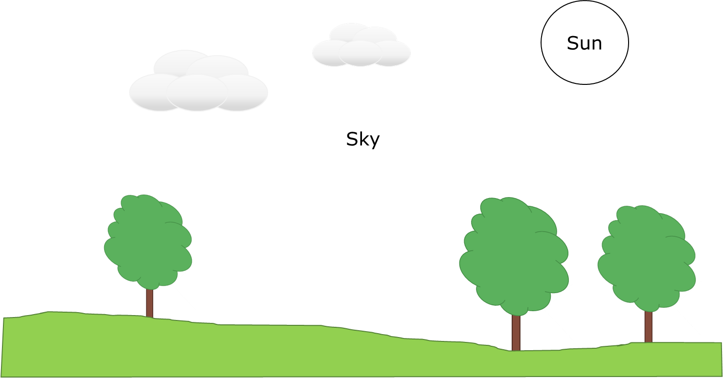
Light and day
1. What colour is sunlight?
Yellowish
Mixture of yellow, orange and red
Blue
None of the above

Slide 3
Light and day
1. What colour is sunlight?
2. What colour is daylight?
Yellowish
Mixture of yellow, orange and red
Blue
None of the above

